Slide 1
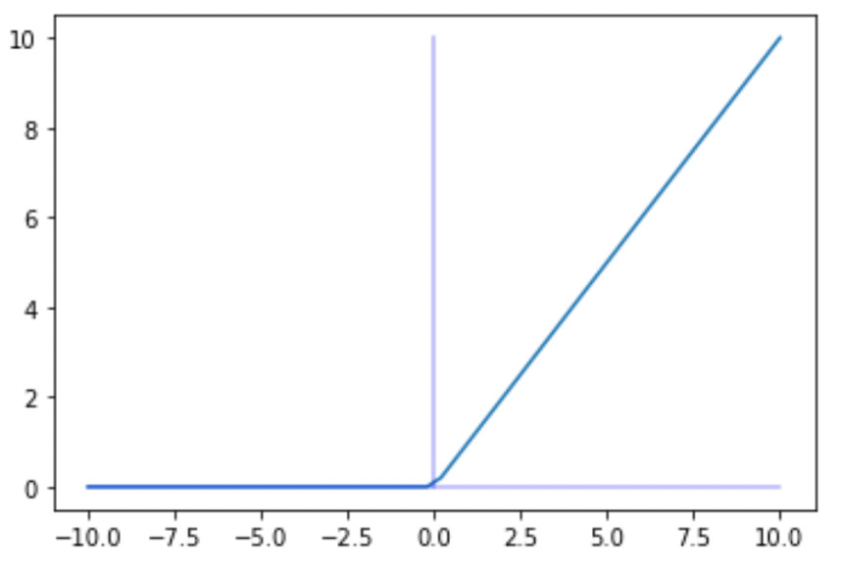

Activation Function from Scratch

Slide 2
Reference
tf.keras.activations
Youtube
Code

Slide 3
Relu and Its Variants

Slide 4
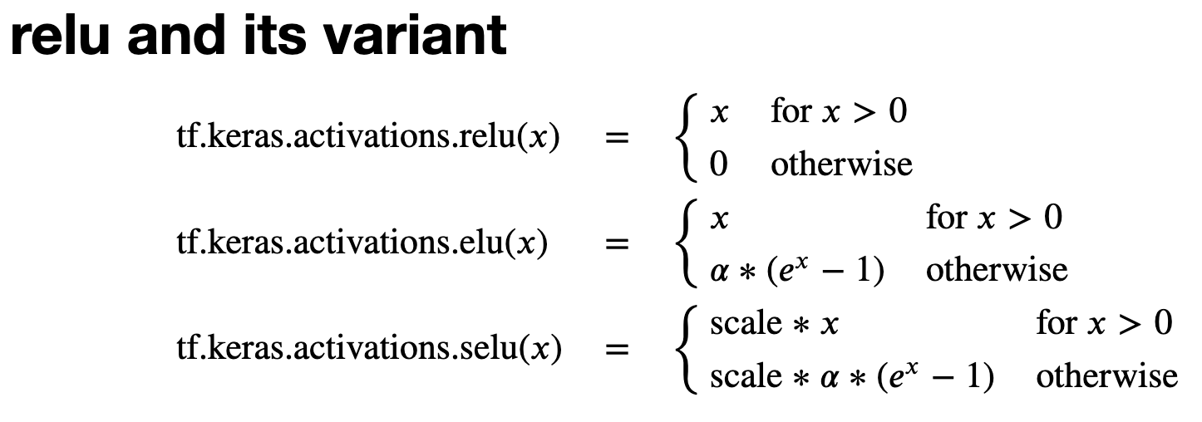

Slide 5
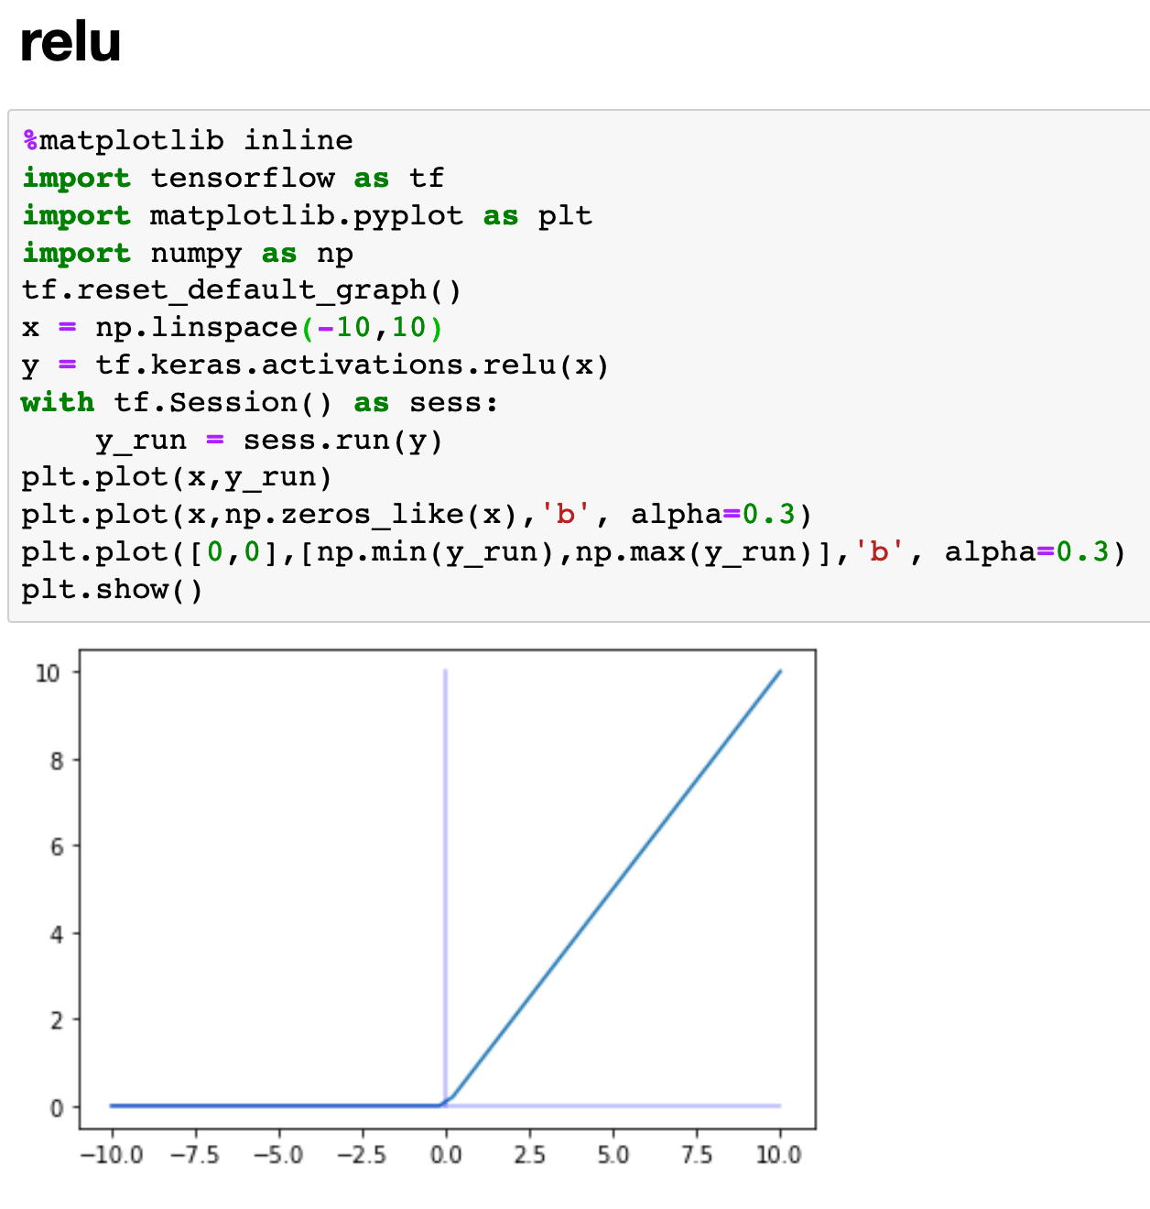

Slide 6
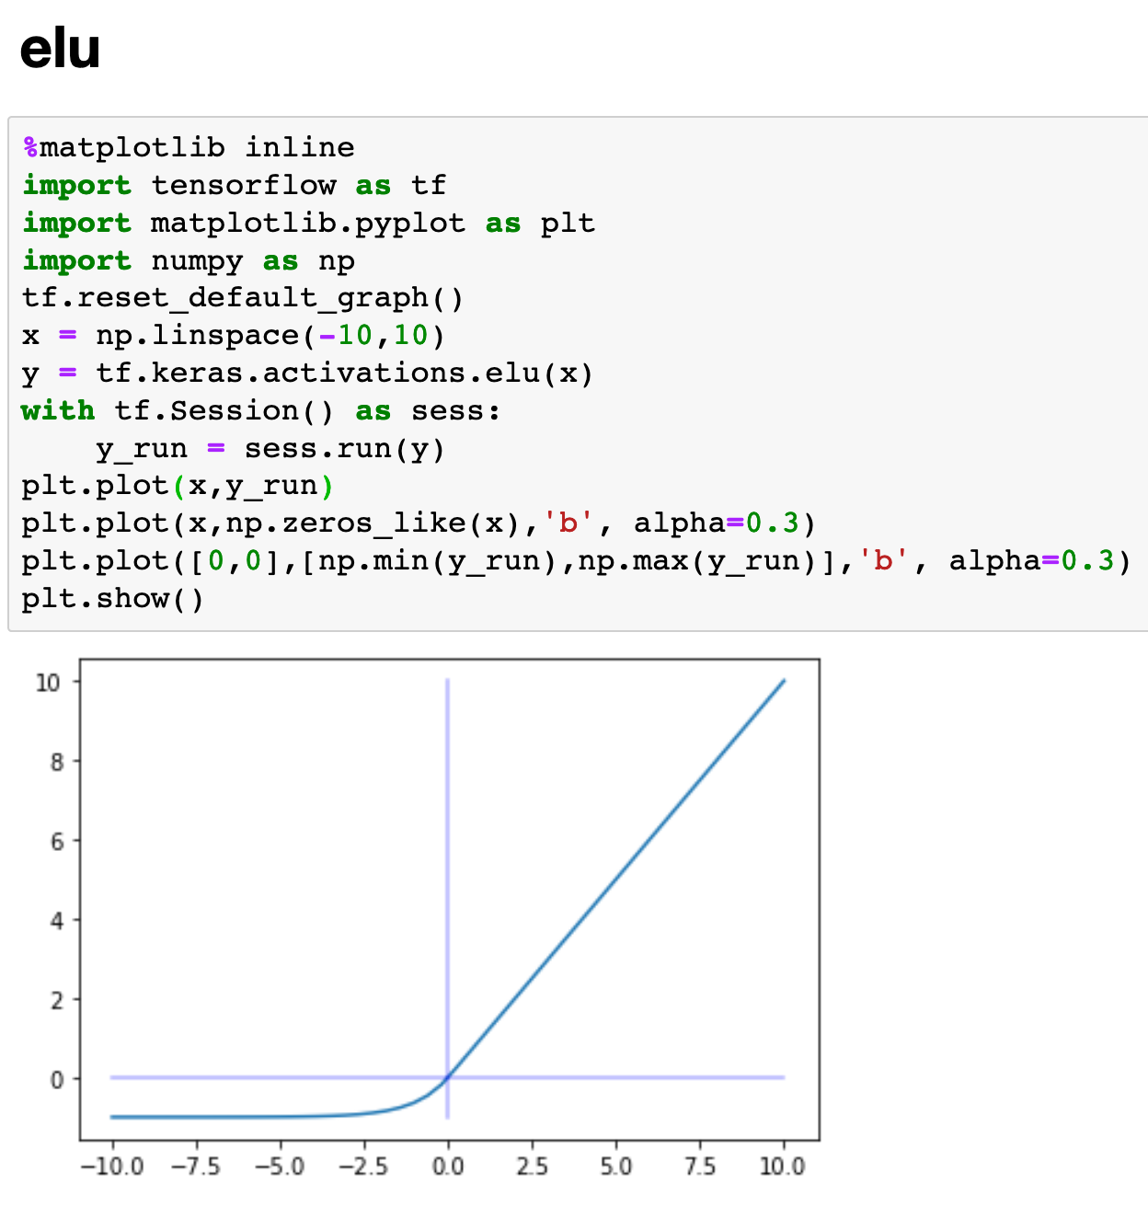

Slide 7
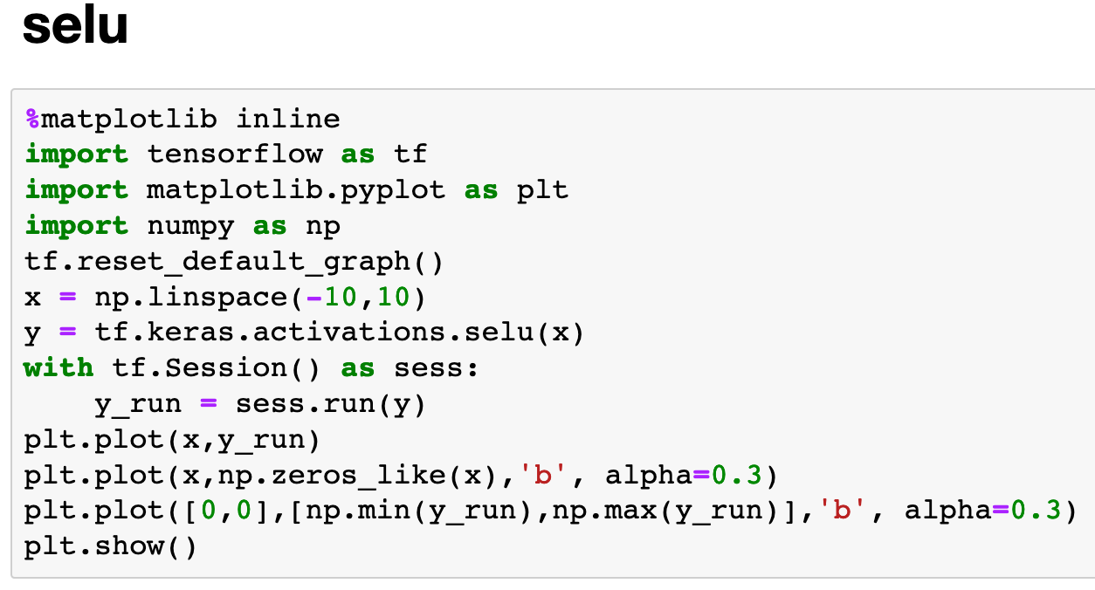
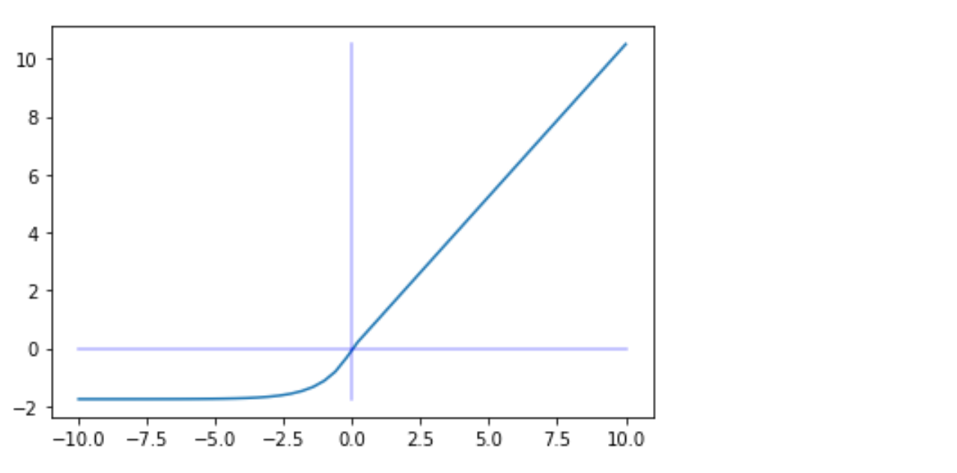

Slide 8
Sigmoid and Its Variants

Slide 9


Slide 10
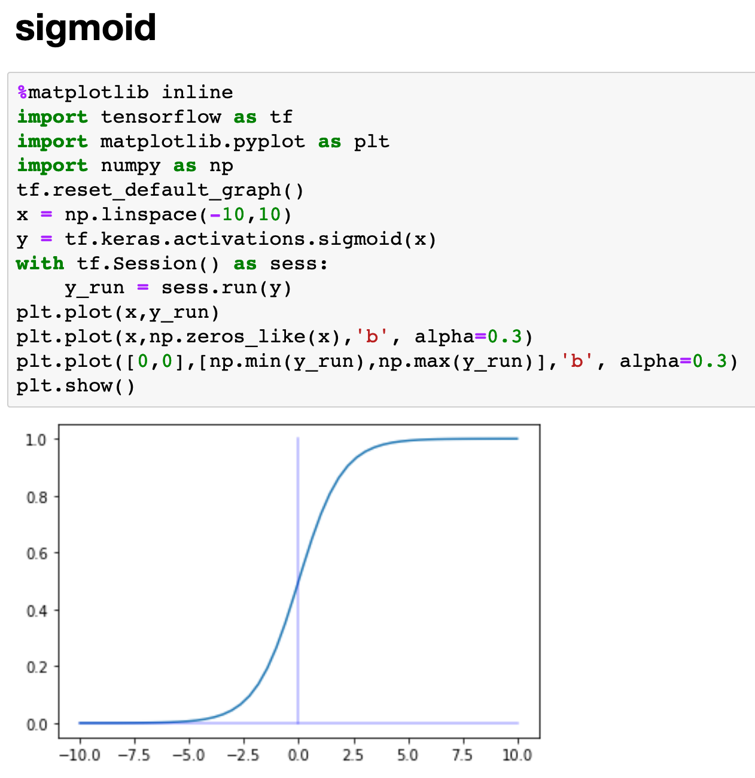

Slide 11
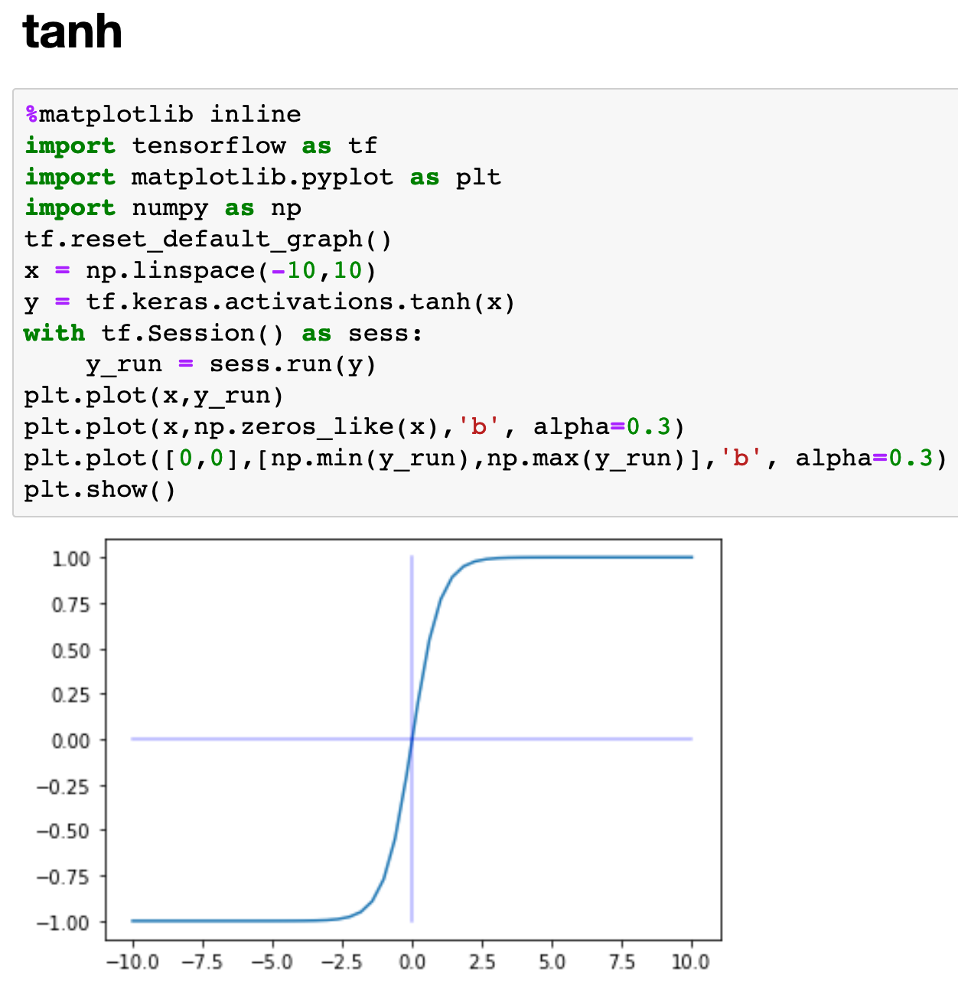

Slide 12
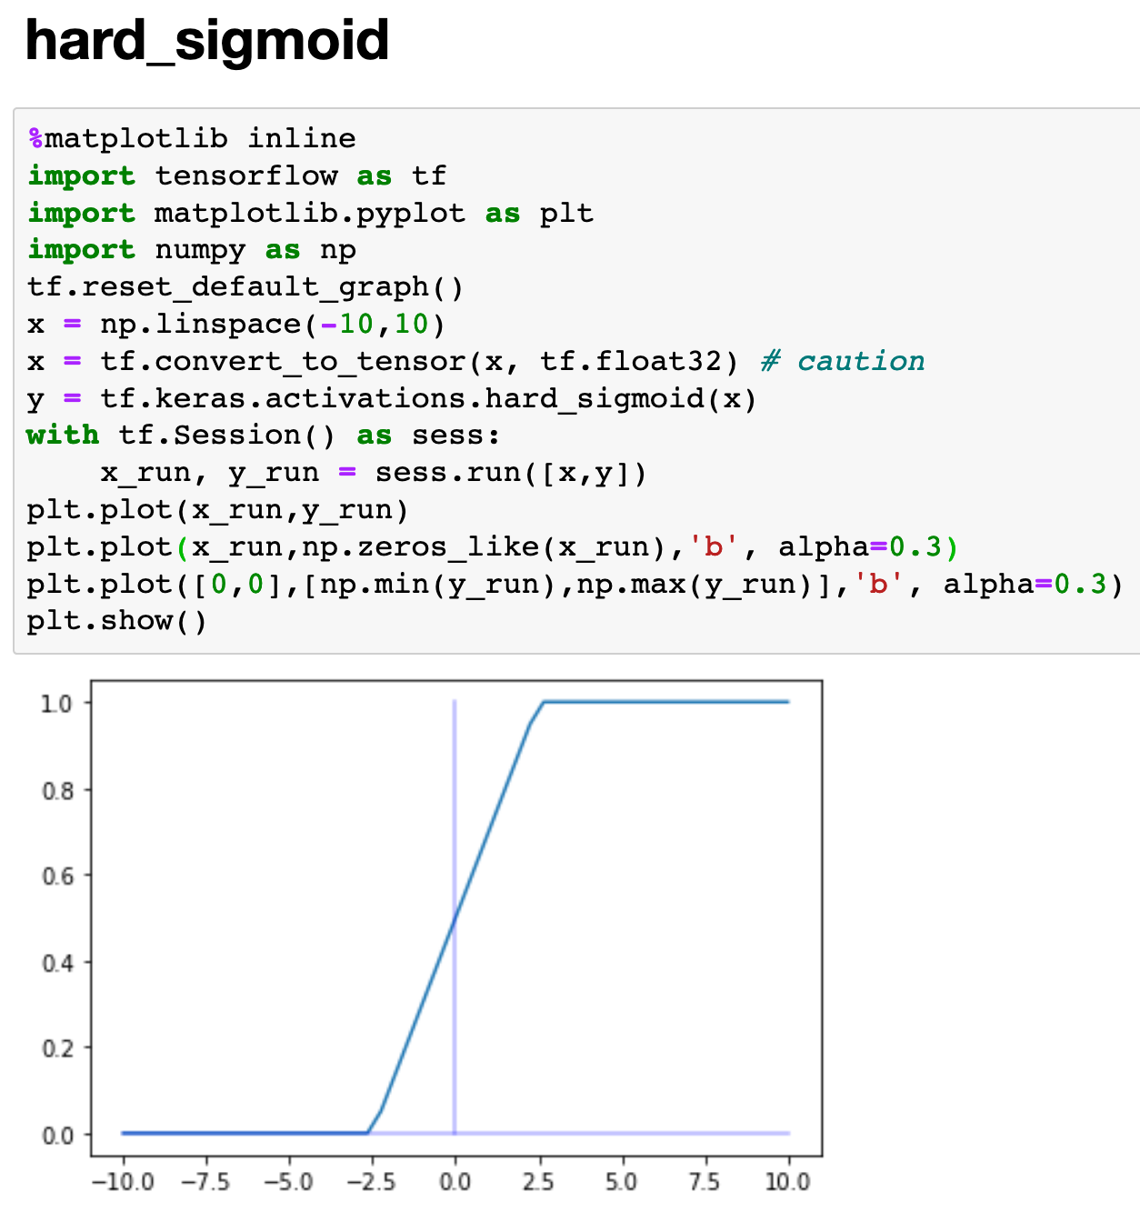

Slide 13
Softmax and Others

Slide 14


Slide 15
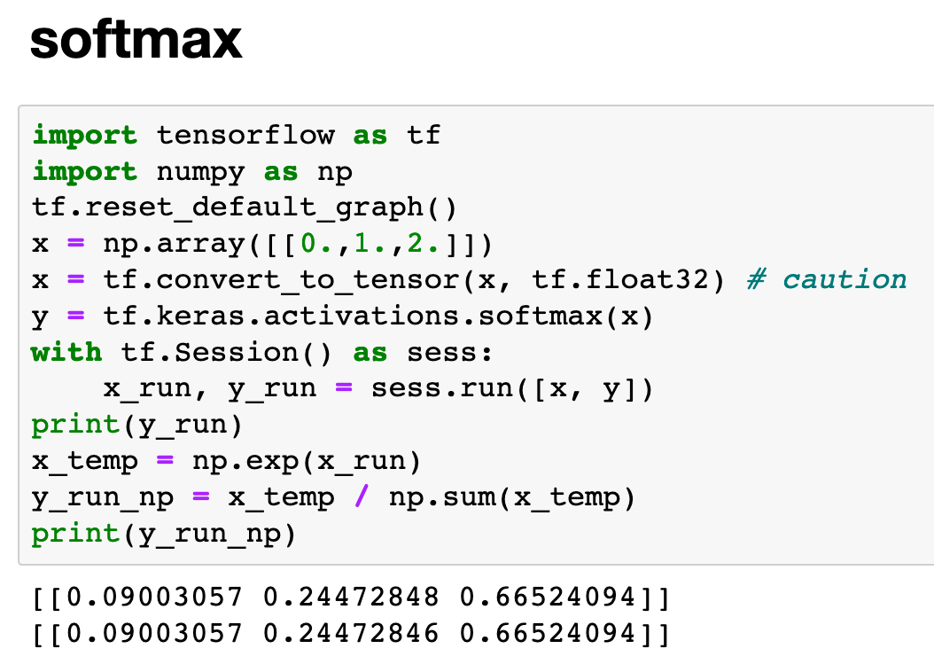

Slide 16
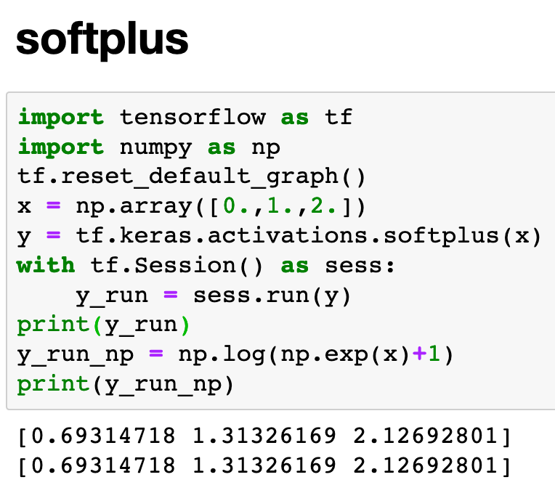

Slide 17
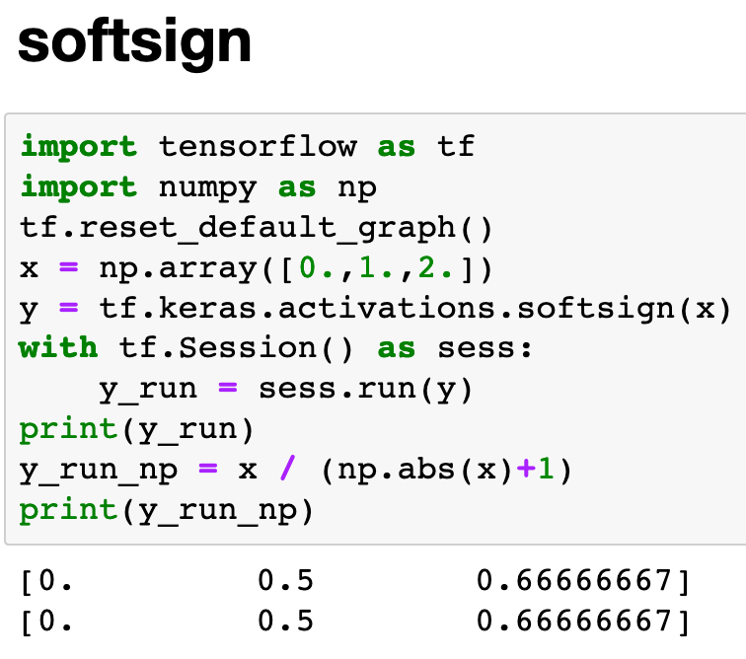

Slide 18
Now
Let’s Play with Code

